Slide 1
Just transition to low carbon futures: Using finance to unlock customer benefits
Asia Clean Energy Forum
15 June 2021

Slide 2
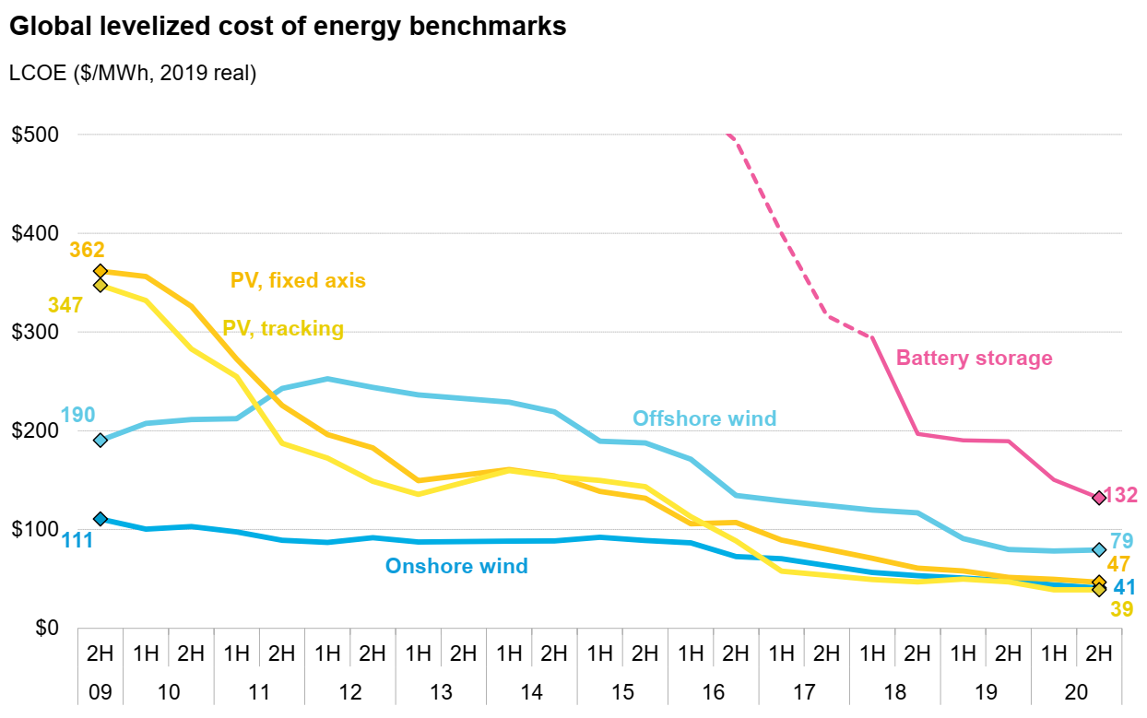
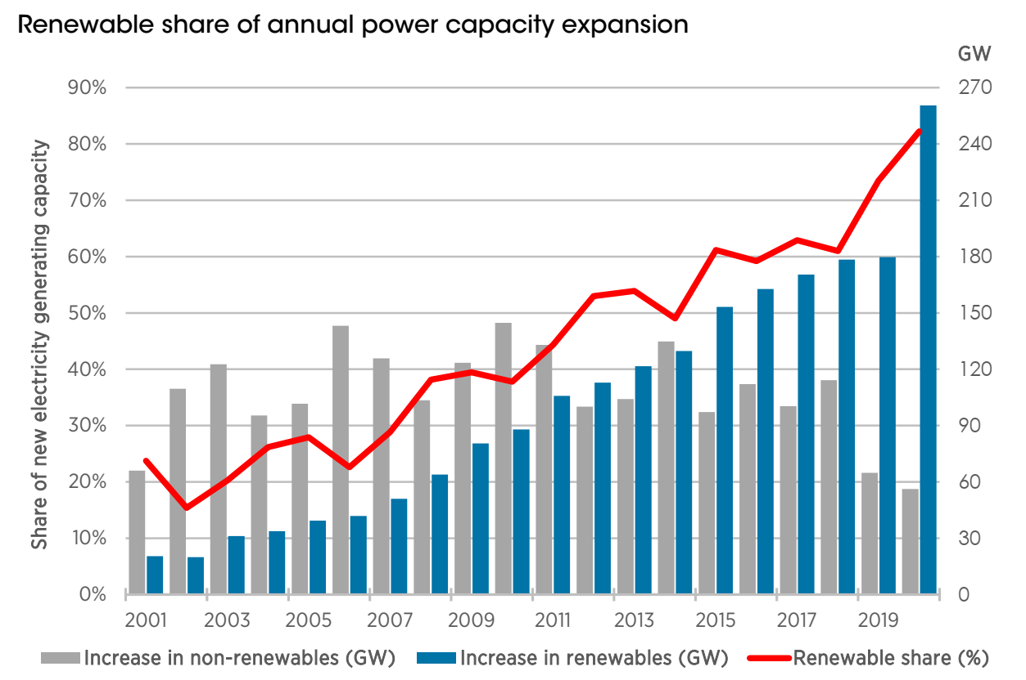
Dramatically shifting landscape of electricity generation, driven by solar, wind, and other clean technologies
Global levelized cost of energy benchmarks
Renewable share of annual power capacity expansion
Source: BNEF Executive Factbook, March 2021
Source: IRENA Renewable capacity highlights, March 2021

Slide 3
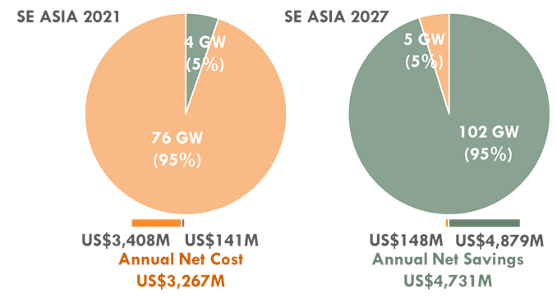
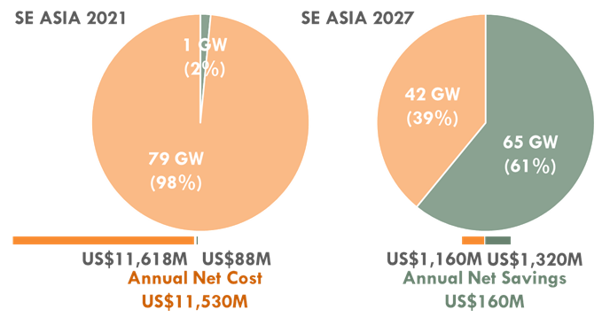
Economic rewards from adoption of new clean energy options can be accelerated when coupled with targeted coal transition
By 2030, RE in Asia Pacific is expected to be cheaper than coal
Cost competitiveness of existing coal vs. new RE
Competitive
Uncompetitive
Cost competitiveness of existing coal vs. new RE + storage
Cost to replace competitive coal
Source: BNEF Executive Factbook, March 2021
Cost to replace uncompetitive coal
Source: Wood Mackenzie, November 2020
Source: RMI analysis, using Global Coal Power Economics (GCPEM) model

Slide 4
… and the opportunity to create savings for customers, deliver environmental and health benefits, and support just transition
Savings
from cheaper electricity
Environmental benefits from lower emissions
Health
benefits from lower emissions
Institutional savings can fund Just Transition
CUSTOMER
WORKERS AND COMMUNITIES

Slide 5
It is important to consider how the role of coal can be adopted in the near to medium term, to support transition
Coal plants can be an important source of medium-term flexibility and that flexibility can be increased in several ways
Current status
Reduce minimum generation level
Enable “two shifting”
(Evening shutdown)
Increase ramping rate
Nameplate capacity (MW)
Adds peak ramping, but for fewer minutes
Flexibility available for ramping or load shifting
Minimum generation
Adjust entrenched behaviors
Upgrade control systems
Major investment and upgrade
Added daily shifting
0
12
24
0
12
24
Hour
Hour

Slide 6
Recent signaling of transition support, will need to be followed by concrete steps to address barriers to energy transition
Vietnam will reduce the total capacity of coal-fired thermal power plants from 2020 until 2030, according to the National Steering Committee for Electricity Development
March 2020
Inflexible contractual obligations with fossil fuel suppliers and generators
Baseload centered structure of existing power systems
The Filipino government will no longer accept proposals to build new coal power plants, in a significant policy shift designed to boost the deployment of renewable energy
October 2020
Subsidies, direct and indirect guarantees make coal generation cheaper than renewables
Indonesian state utility Perusahaan Listrik Negara is aiming to phase out coal-fired power as the country brings forward its carbon neutrality ambitions to 2060
May 2021
Transition impact on jobs and communities, and regional economic futures
Politic-economic integration of the coal economy

Slide 7
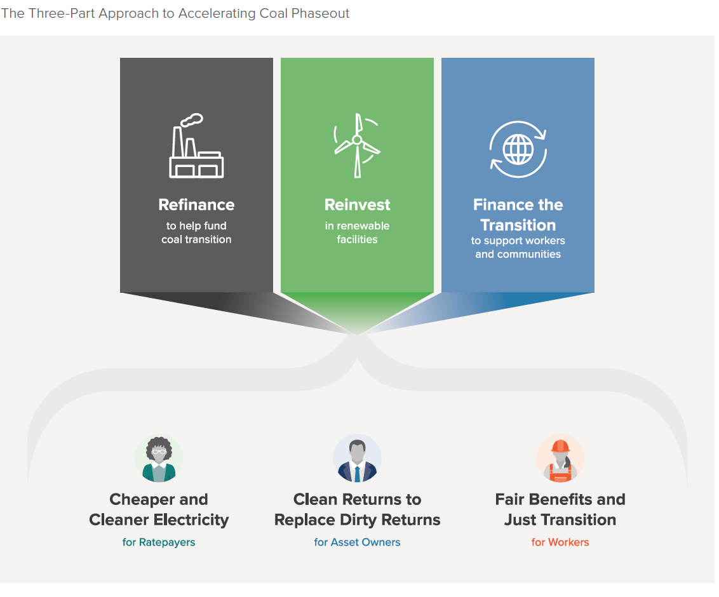
COAL TRANSITION
CAN BE ACCELERATED THROUGH A THREE-PART, INCENTIVE-BASED APPROACH

Slide 8
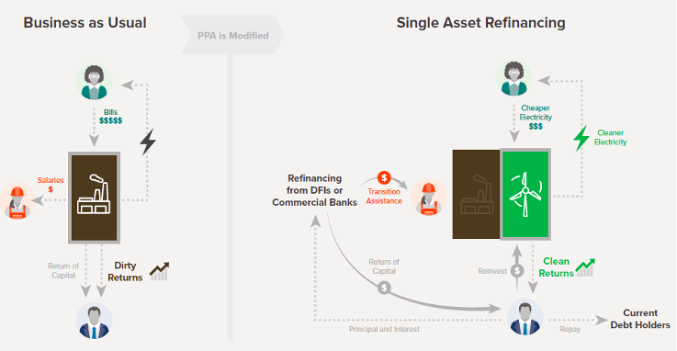
Example of an innovative financial tool that can be used to implement this three-part approach: single asset refinancing

Slide 9
Coal transition is already beginning to happen as other countries / utilities begin to move towards coal transition
US – Securitization legislation has been passed in 7 states, with several more having introduced or passed some level of legislation
Germany – The country’s coal phase-out legislation to end coal-fired power generation by 2038 and the government recently spent, EUR 317m to close loss-making plants
South Africa - In March 2020, Eskom issued an expression of interest calling for business cases to repurpose 3 coal power stations scheduled to retire between 2022 and 2026
Poland - Silesia, the largest hard coal mining region in the EU where more than 70 thousand workers are employed in the mines, is in the middle of preparations for the transition away from coal
Chile - The Chilean government’s decarbonization plan to phase out its coal power fleet by 2040 (8 plants with and 20 plants. A $125 million financial package ($74 million senior loan from IDB Invest, $15 million of blended financing from the Clean Technology Fund and $36 million from the Chinese Fund for Co-financing in Latin America and the Caribbean)

