Slide 1
Email and Data Protection
E-Safe Technologies
March 29, 2018

Slide 2
Email Protection

Slide 3
Targeted Attacks Start with Email
It’s been true for so many years it’s become a security vendor cliché: email is the number one threat vector for modern business.
There are plenty of stats you can cite. This one is vendor neutral from SANS. Other vendors have pegged this number as high as 91%.
The point is that email is a huge source of risk – but it’s not just targeted attacks we have to worry about….
74%
2017 Threat Landscape Survey: Users on the Front Line - SANS Analyst Program
Confidential
Notes:
It’s become a security industry cliché that email is the number one threat vector.
Here’s a recent data point. In the 2017 Threat Landscape Survey: Users on the Front Line, conducted by the SANS Analyst Program, for the Top Threat Vectors - 74% of the threats entered as an email attachment or link. https://www.sans.org/reading-room/whitepapers/threats/2017-threat-landscape-survey-users-front-line-37910
Other studies and estimates have put this percentage as high as 90% or more.
Clearly email is a huge source of risk for modern organizations.
Let’s take a look at some recent examples to unpack the reasons why

Slide 4
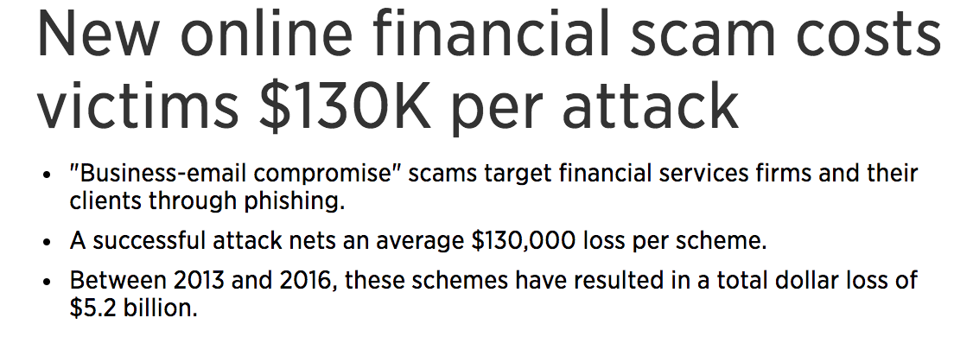
Confidential
Notes:
Almost everyday we hear about a new phishing/spam/malware/ ransomware attack.
Here are some examples pulled from the headlines
These threats are a constant worry for small, medium and large organizations across all industries.
From volumetric spam to regulatory compliance issues to CEO impersonation or “business email compromise” attacks email remains a target

Slide 5
And it gets more complex every year
Unified Mobile Inboxes and Unsecured Executive Personal Accounts
Spear Phishing,
Whaling, BEC,
CEO Fraud, Socially Engineered Phishing
Ransom-ware
Risk and Complexity
Brand Erosion, Email Trust
Phishing
Zero Day Attacks
SOX, HIPAA, FINRA
eDiscovery
Volumetric Spam and Malware
2000
2018
Time
Confidential
Notes:
[NOTE: this slide is intentionally a bit of an oversimplification. If you get someone who nitpicks the order or phrasing, just say “you’re absolutely right. This is an oversimplification that’s here to make a point”]
In fact, things seem to be getting more complicated and risky over time
This makes sense – as our defenses get better, the adversary exhaust the low hanging fruit and have to turn to more sophisticated attacks
In the early days, it was a “spray and pray” approach – cast a wide net and prey on a large volume of unsophisticated targets
In the wake of Enron, regulations started to crack down on computing controls, and stringent regulations like SOX and HIPAA looked at email as a source of compliance risk
The bad guys realized that antivirus was doing an ok job stopping run of the mill spam and malware, so they started writing custom, “zero day” attacks that could evade traditional email
They realized that humans are the weakest link in the security defense chain and started launching phishing attacks
As phishing attacks used corporate brands, companies found that they lost customer trust and had more trouble engaging customers through email
Ransomware was an innovation that helped criminals more easily monetize their activity
And continuing with the theme of ease of monetization, attackers started using social engineering to convince executives to wire funds or disclose sensitive information
And as corporate defenses got better, the bad guys have started phishing executioves through unsecured personal accounts. With the rise of unified inboxes, it’s not always clear whether an email is from a personal or corporate account, which helps them succeed

Slide 6
Barracuda Networks – the Email Protection Company
Protecting and processing 1 billion emails a day
Over 60,000 email protection customers
Artificial Intelligence email threat defense engine trained on 2.5 million emails
17 billion messages archived
Leader in spam and virus prevention since 2003
Confidential
Notes:
At Barracuda, we’ve been on the front lines of the battle since 2003 and we know a few things about email

Slide 7
Our mission and vision: Deliver comprehensive, easy-to-use protection against the most advanced email-borne threats to your people, brand and business

Slide 8
Our three value pillars
Comprehensive protection against evolving email borne threats…
...with safeguards for your people, brand and business…
...in an elegantly simple, intuitive and easy to deploy solution

Slide 9
Supporting Pillar One
Comprehensive protection against evolving email borne threats…
Industry’s best protection against socially engineered targeted attacks like business email compromise and CEO fraud
Rich threat intelligence from multiple vectors – email, web and network – for continuous detection of zero-day threats
Full portfolio of data protection capabilities that provide resiliency and easy recovery from ransomware and accidental data loss
Notes:
Protecting 1 billion emails a day
Broad security portfolio with a global threat intelligence architecture that spans web, network and email
AI trained on 2.5 million mailboxes
Barracuda customers never pay ransomware
Sold more backup units in Q2 2017 than the next four competitors combined
The first email security company to use artificial intelligence to predict future attacks
The broadest range and depth of machine learning samples in the industry.
Top player in 2017 Radicati Group Secure Email Gateway Market Quadrant (the only email security stack rank report)

Slide 10
Supporting Pillar Two
...with safeguards for your people, brand and business…
Integrated intelligent training and simulation turns your people into another line of defense against phishing even on personal accounts
Mitigating compliance risk with a tamper-proof archive that makes responding to e-discovery requests easy
Reduce reputational risk with protection from spoofing, fraud and brand hijacking through rich DMARC enforcement and reporting
Notes:
Gartner recognized visionary for Security Awareness Computer Based Training
Trusted by Fortune 100 enterprise customers including a top 5 US health insurer
Barracuda has more than twice as many email security customers (~60,000) as Proofpoint and Mimecast combined
17 billion messages archived
2 million messages archived an hour
Leader in the spam prevention business since 2003.
Integrated DMARC enforcement and reporting protects your corporate identity from being hijacked and misused

Slide 11
Supporting Pillar Three
...in an elegantly simple, intuitive and easy to deploy solution
Lightning fast time to value. Minimal customization needed with sensible defaults. Nothing to install and nothing to deploy. Highly usable administrative interface
Adaptive security automatically tunes itself to your organization, eliminating painful setup and whitelisting
Industry’s best support team, here with you every step of the way
Notes:
Top rated support 7 years running (SC Magazine)
Monthly “ClickThinking” newsletter with turnkey content keeps you relevant with minimal effort
Pre-built templates for quick time to value
Setup wizard to get up and running within minutes
Users can manage their own filters and email quarantine, and continue working even in the event of an email server outage.
Sentinel provides immediate visibility into threat posture based on historical data
Centralized and unified management consoles
Free 30 day trials with no obligations
Aggressive SLAs
Mobile applications and plugins provide on demand access
Setup, monitor, and enforce DMARC email authentication with a few simple clicks

Slide 12
The Product Story

Slide 13
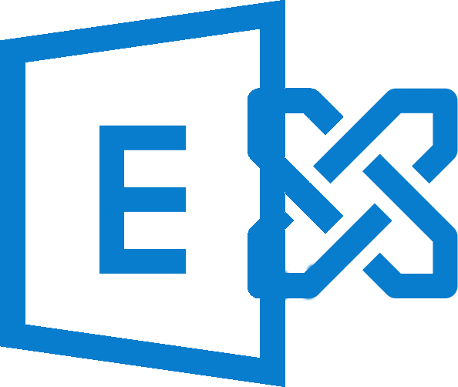
In the early days, it was simple
Legitimate Mail
Internet
Mail Server
Corporate Inbox
Executives
Notes:
So to give a little more context to the threat landscape, let’s look at the evolution of our defenses.
In the early days it was simple – legitimate mail would come across the internet, land in a mail server, get delivered into an inbox and users would send and receive

Slide 14
Spam firewalls kept bad things out
Spam/malware
Legitimate Mail
Spam Firewall
Internet
Mail Server
Corporate Inbox
Executives
Notes:
In the early 2000’s, spam and malware started being sent via email more frequently
Barracuda pioneered the spam firewall, which let legitimate mail through but stopped spam and malware

Slide 15
Over time, we built a better gateway
Spam/malware
Legitimate Mail
Spam Firewall, DLP, Backup, Archiving
Internet
Mail Server
Corporate Inbox
Executives
Notes:
As threats evolved, we improved on the spam firewall, which became the modern email gateway
We included things like data loss prevention and encryption to stop leakage of sensitive information
Backup and archiving, which don’t actually sit on the gateway, provided important capabilities to recover from accidental deletion and to archive mail for compliance or storage purposes

Slide 16
Sandboxing stopped zero day threats
Spam/malware
Legitimate Mail
Spam Firewall, DLP, Backup, Archiving, Sandboxing
Internet
Mail Server
Corporate Inbox
Executives
Zero Day
Notes:
With the rise of zero day threats – threats that were new or custom and therefore couldn’t be caught by backwards looking signatures – the industry needed a new approach
Sandboxing is a technique that doesn’t rely on having seen a specific attack before. It puts a potentially malicious message into a virtual environment to see if it does anything nefarious

Slide 17
But gateways are blind to social engineering
Spam/malware
Legitimate Mail
Spam Firewall, DLP, Backup, Archiving, Sandboxing
Internet
Mail Server
Corporate Inbox
Executives
Zero Day
Social Engineering
Notes:
But both traditional gateway security and advanced threat protection techniques like sandboxing both rely on spotting a malicious payload
These defenses look for a piece of malware – either a bad attachment with a virus or a link to a malicious website
Social engineering attacks don’t contain links or attachments – they try to trick users into doing something
To a gateway, a social engineering, business email compromise or CEO fraud attack looks just like any other piece of email

Slide 18
And attacks are coming in through the back door
Spam/malware
Legitimate Mail
Spam Firewall, DLP, Backup, Archiving, Sandboxing
Internet
Mail Server
Corporate Inbox
Executives
Zero Day
Social Engineering
Personal Email
Spear Phishing
Notes:
As if that weren’t bad enough, the bad guys have realized that executives frequently access both work and personal email from a unified inbox
The unsecured personal email account is a soft entry point into the executive inbox, and as a result phishing attacks through the back door can be brutally effective

Slide 19
Securing the gateway is still necessary, but no longer sufficient
Confidential
Notes:
In the early 2000’s, the network security perimeter collapsed – it became important to secure data wherever it lived on the network
We are at a similar moment for email security
Securing the gateway is still necessary, but the threats have moved beyond the gateway. It’s no longer sufficient.

Slide 20
Next Generation Email Protection
Human Firewall
Phishing Simulation and Training
AI-based Spear Phishing Protection
DMARC to Prevent Brand Hijacking
Fraud Protection
Resiliency
Cloud Backup
Email Continuity
Inbound/Outbound
Security
Encryption and DLP for Secure Messaging
Archiving for Compliance
Gateway Defense
O365 | Gsuite | Exchange
Confidential
Notes:
So what does a modern email protection stack look like?
It all starts with the mailbox. Whether you’re on a cloud service like Office 365 or Gsuite, on prem or in a hybrid configuration, the defenses are the same
The gateway is as important as ever, so make sure you have inbound and outbound security deployed, including traditional signature defenses and advanced techniques like sandboxing. Secure yourself against accidental and malicious data loss with encryption and DLP and archive important emails for compliance and/or storage reasons
On top of that, ensure resiliency with backup to recover from accidental or malicious deletion of data and a continuity service to ensure that critical emails can get sent during an outage
To stop attacks that bypass the gateway, artificial intelligence can predict how likely an email is to be to or from the person it purports to be from
And the DMARC standard is useful to make sure that bad actors aren’t send sending spam and phishing attacks using your domain and brand
Finally, as the last line of defense against email that comes in through personal accounts, it’s critical to turn your users from a liability into a control. Phishing simulation and training makes your executives resilient.

Slide 21
Barracuda Email Protection
Human Firewall
Barracuda PhishLine
Fraud Protection
Barracuda Sentinel
Resiliency
Barracuda Essentials
Gateway Defense
O365 | Exchange
Confidential
Notes:
In fact, we’ve built our product portfolio to support that layered approach to security
Barracuda Essentials provides gateway defenses and resiliency
Barracuda Sentinel stops brand hijacking and catches social engineering attacks using artificial intelligence
And Barracuda PhishLine provides the last line of defense – training your employees to spot and thwart phishing attacks on unsecured personal accounts
The approach is totally modular, letting you layer in defense where you need a boost, or use all three components for the ultimate in protection

Slide 22
Barracuda’s EP portfolio
Employee Defense
Phishing Simulation and Training
API Inbox Defense
AI for Social Engineering
Resiliency
Cloud Backup
Continuity
Inbound/Outbound
Security
Compliance and e-discovery Archiving
Brand Misuse Prevention (DMARC)
Gateway Defense
O365 | Exchange | GSuite
Notes:
We saw this slide before, and we’ll see it again to reinforce the breadth of our security portfolio.
Also, we want to contrast it with the security features Microsoft provides.

Slide 23
…vs. Microsoft O365
Employee Defense
Phishing Simulation and Training
API Inbox Defense
AI for Social Engineering
Resiliency
Cloud Backup
Continuity
Inbound/Outbound
Security
Compliance and e-discovery Archiving
Brand Misuse Prevention (DMARC)
Gateway Defense
O365 Mailbox
Notes:
Microsoft provides email security with Exchange Online Protection (EOP) and Advanced Threat Protection (ATP) and includes both archiving and eDiscovery capabilities, but that’s where they stop.
They don’t offer the comprehensive solution to email security that we do.

Slide 24
…vs. Mimecast
Employee Defense
Phishing Simulation and Training
API Inbox Defense
AI for Social Engineering
Resiliency
Cloud Backup
Continuity
Inbound/Outbound
Security
Compliance and e-discovery Archiving
Brand Misuse Prevention (DMARC)
Gateway Defense
O365 Mailbox
Notes:
Microsoft provides email security with Exchange Online Protection (EOP) and Advanced Threat Protection (ATP) and includes both archiving and eDiscovery capabilities, but that’s where they stop.
They don’t offer the comprehensive solution to email security that we do.

Slide 25
…vs. ProofPoint
Employee Defense
Phishing Simulation and Training
API Inbox Defense
AI for Social Engineering
Resiliency
Cloud Backup
Continuity
Inbound/Outbound
Security
Compliance and e-discovery Archiving
Brand Misuse Prevention (DMARC)
Gateway Defense
O365 Mailbox
Notes:
Microsoft provides email security with Exchange Online Protection (EOP) and Advanced Threat Protection (ATP) and includes both archiving and eDiscovery capabilities, but that’s where they stop.
They don’t offer the comprehensive solution to email security that we do.

Slide 26
Data Protection

Slide 27
Data Is Moving Around
Notes:
Datacenters, employees same place
Data was created and accessed from same place
Now – distributed environments, remote/sales offices, buses trains cars planes
Mobile
Data is distributed, needs to be accessed from anywhere

Slide 28
Platforms are Changing
Notes:
Legacy physical
Saas applications
Public cloud platforms – azure AWS

Slide 29
Hybrid Environments
Notes:
What’s worse – most organizations have a mix of legacy physical servers, virtual environments, and cloud that needs to be protected – further complicating their data protection needs.

Slide 30
Threats Stay The Same

Slide 31
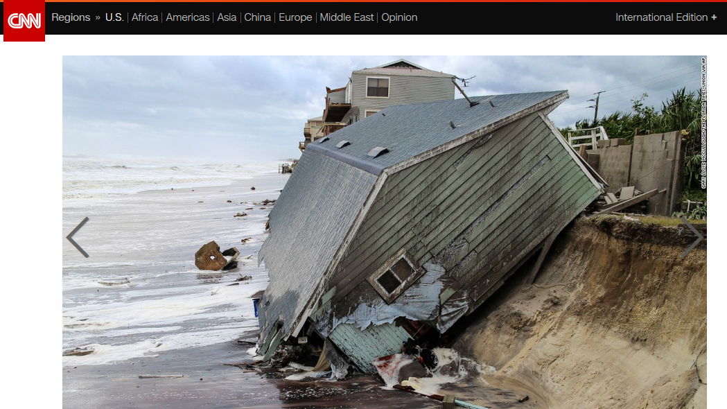
Threats stay the same!
Notes:
But what hasn’t changed… are the threats
Natural disaster

Slide 32
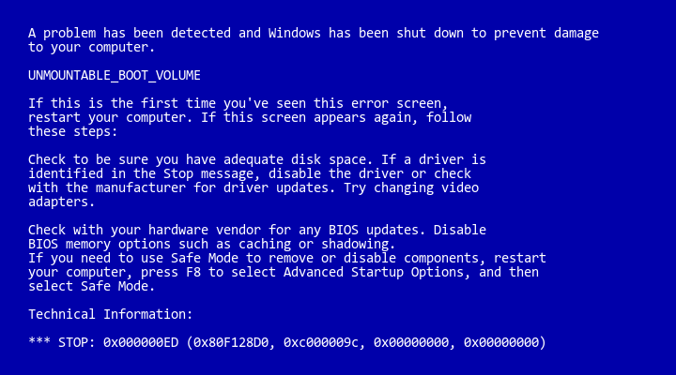
Threats stay the same!
Notes:
Data corruption

Slide 33
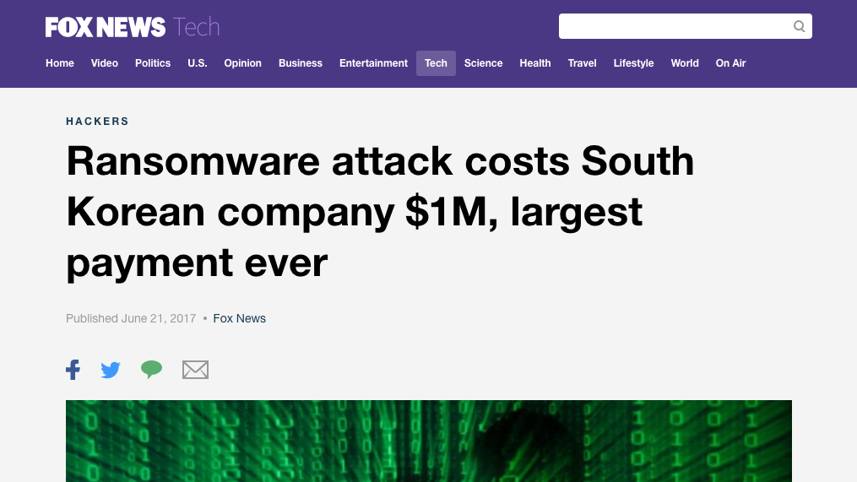
Notes:
Ransomware is top of mind for every organization

Slide 34
Threats stay the same!
Notes:
Human error
Used to be –
Now…
Remember when S3 was down a few months ago?

Slide 35
Notes:
And gitlab also
Not barracuda Backup

Slide 36
60%
of companies that lose their data will shut down within six months of the data loss disaster
-National Archives & Records Administration in Washington
Notes:
It’s become a security industry cliché that email is the number one threat vector.
Here’s a recent data point. In the 2017 Threat Landscape Survey: Users on the Front Line, conducted by the SANS Analyst Program, for the Top Threat Vectors - 74% of the threats entered as an email attachment or link. https://www.sans.org/reading-room/whitepapers/threats/2017-threat-landscape-survey-users-front-line-37910
Other studies and estimates have put this percentage as high as 90% or more.
Clearly email is a huge source of risk for modern organizations.
Let’s take a look at some recent examples to unpack the reasons why

Slide 37
No matter what, data still needs to be protected

Slide 38
Advanced Persistent Threats
Data Corruption
Human Error
Notes:
We must protect against data corruption, advanced persistent threats such as ransomware, and human error – which used to be somebody spilling their coffee on the server or tripping over network wires, but today means an incorrectly configured application or users accidentally, but permanently deleting important information.

Slide 39
Barracuda is the Data Protection Company
Worldwide unit volume leader 22 quarters in a row
Over 39,000 active backup appliances deployed
Protecting 215,000 servers worldwide
Creating 4.8 million backups a month
Replicating 365 terabytes of data every day
Serving 40,000 customers with 90 billion messages archived
Confidential
Notes:
At Barracuda, we’ve been on the front lines of the battle since 2003 and we know a few things about email

Slide 40
Our mission and vision: Enable businesses to run seamlessly by minimizing downtime and preventing data loss providing the industry’s easiest to deploy and manage all-in-one data protection solution

Slide 41
Our Three Value Pillars
We provide rapid recovery from today's advanced threats, disasters, and human error…
and enable distributed organizations to orchestrate their data protection strategy from a single, centralized console
…while eliminating piece-meal, multi-vendor products by providing fully-integrated solutions.

Slide 42
Supporting Pillar One
We provide rapid recovery from today's advanced threats, disasters, and human error…
Restore maliciously encrypted files and folders in the event of a ransomware attack without paying ransom.
Easily recover lost or corrupted data to minimize data loss, downtime, and lost productivity.
Rapidly spin up downed virtual machines in the event of disaster to get the organization up and running as soon as possible.
Notes:
Hayward Tyler was hit with a ransomware attack, but thanks to Barracuda Backup, the criminals didn’t get a penny, and Hayward Tyler got right back to work.
Attackers tried to take down Bingham County servers with ransomware and demanded over $25,000, but Bingham County didn’t have pay, nor did they lose a thing because they were protected by Barracuda Backup.
"Barracuda Backup has provided us with seamless restores... It is great to be able to restore files that may have been inadvertently deleted or saved over good data. Now file restores are simple and fast.” -Mechanicsburg Area School District

Slide 43
Supporting Pillar Two
and enable distributed organizations to orchestrate their data protection strategy from a single, centralized console
Configure data sources, schedule backups, and recover data across distributed infrastructures from a centralized management console.
Cloud-hosted management can be accessed from anywhere in the world without the need for VPN tunnels.
Notes:
"Unboxing to backing up our entire @VMware infrastructure took 10 minutes. Simple." -StorageReview.com
Over 300 backup appliances across thousands of servers managed through a single administration console for one of our MSP partners.
Drew Marine needed a quick solution to protect data across 20 locations. They deployed 11 Barracuda Backup appliances without the need for additional IT staff.

Slide 44
Supporting Pillar Three
…while eliminating piece-meal, multi-vendor products by providing fully-integrated solutions.
Single solution to protect physical, virtual, and SaaS environments.
Flexibility of physical appliance and virtual appliance (software) based deployments for local backups.
Choice of replication to a remote physical appliance, virtual appliance (software), Barracuda Cloud, or public cloud for offsite protection.
Notes:
Worldwide unit volume leader in purpose-built backup appliances (PBBA) for the last 22 quarters in a row. -International Data Company (IDC)
Over 39,000 purpose-built backup appliances deployed worldwide.
American Radio Relay League needed a straightforward solution to protect a mix of 45 virtual and physical email, database, and file servers. Barracuda Backup helped cut time spent on backups by 90%.

Slide 45
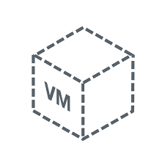
Traditional backup looks like…
Local Storage
Compute Resources
Backup Software
Software Licensing
Backup Agents
Virtual Backup
Offsite Storage
Cloud Storage

Slide 46
Barracuda Backup makes it easy
Notes:
Are you currently deploying complicated multi-vendor solutions instead of an all-in-one appliance?
Do you not have the resources for a remote data center for offsite replication?
Do you not have enough time to manage complex backup products?
Are you managing multiple backup products for different sources?
Are you still using tape for backup?

Slide 47
Easy to Buy
All-in-one backup appliance with simple pricing
Flexible virtual appliance software solution that is licensed per socket to align with familiar VM pricing models
Complete protection with Cloud-to-Cloud backup for Microsoft Office 365 based on per-user pricing
Per Application Fees
Complex Pricing
Replication Fees
Agent Fees
Virtual Backup Fees
Notes:
We don’t believe in nickel-and-diming our customers, so we made Barracuda Backup easy to buy.
We Offer simple pricing with no per-application or per-feature fees, no agent fees and no complex pricing like you would find with most other backup solutions.
In fact, just think about when you were looking at commvault or symantec, now veritas – how many line items were on that PO? 10-20-sometimes-50? Barracuda Backup POs have 2-4 line items, making it easy, and simple to buy

Slide 48
Easy to Install
Notes:
Something we’re super proud of at Barracuda is how easy Barracuda Backup is to install.
Most deployments take less than an hour from unboxing to up and running, and replicating data remotely. We sent one of our larger Barracuda Backup 890 solutions to Storage Review and they were able start backing up their entire VMware infrastructure in 10 minutes. 10 minutes!
In fact, one of our Barracuda marketing guys were able to get his up and running in 14 minutes with no prior experience whatsoever. That’s how easy Barracuda Backup is to install.

Slide 49
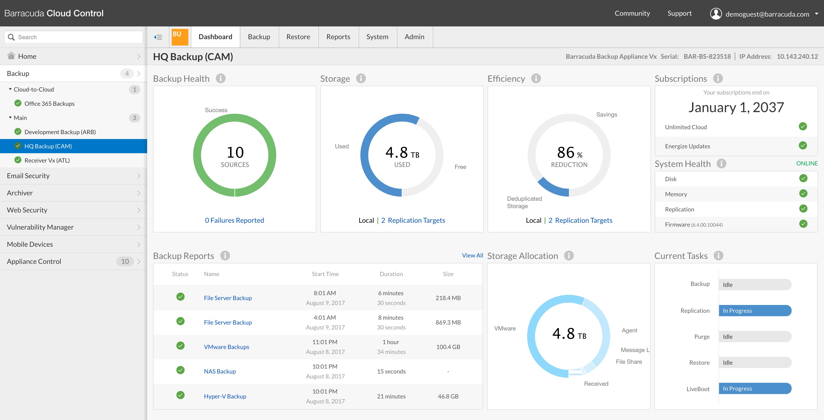
Easy to Manage
Notes:
So now that I’ve shown you how easy Barracuda Backup is to buy and install, let me explain how easy it is to manage from a day-to-day perspective.
Like our other Barracuda products, Barracuda Backup can be managed with Cloud Control – our cloud-based central management that offers seamless multisite administration for all our products. So you can manage backups from your desk, a hotel when you’re on the road, or even on the beach while you’re sipping piña coladas.
For organizations that are cloud-adverse or running in private environments, Barracuda Backup can also be managed with Local Control – our easy local management interface.

Slide 50
Barracuda Backup
Notes:
So as a complete solution, customers can protect physical servers, virtual machines, and SaaS applications with Barracuda Backup. The solution can be deployed as an all-in-one physical appliance or as software that leverages existing storage and compute infrastructures. Data can then be replicated to Barracuda Cloud, Amazon Web Services, remote physical appliances, or remote virtual appliances for ultimate flexibility. And for customers who have extended retention policies, we offer long-term retention through offsite vaulting to Barracuda Cloud, or the ability to export into external media, tapes, or AWS VTLs

Slide 51
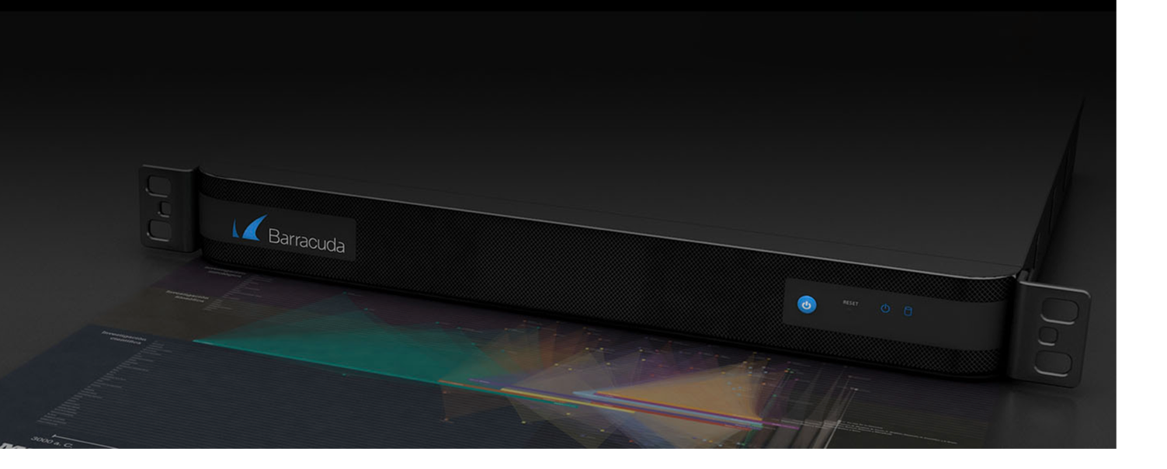
Physical Appliances
 | 190 | 290 | 295 | 390 | 490 | 690 | 790 | 890 | 895 | 990 | 995 | 1090
Usable Capacity | 1 TB | 2 TB | 2 TB | 4 TB | 6 TB | 12 TB | 18 TB | 24 TB | 36 TB | 48 TB | 80 TB | 112 TB
Recommended Environment | 500 GB | 1 TB | 1 TB | 2 TB | 3 TB | 6 TB | 9 TB | 12 TB | 18 TB | 24 TB | 40 TB | 56 TB
*190 and 295 use desktop form factor
Notes:
So diving deeper into the physical appliances. We’ve made significant upgrades to the portfolio over the past year. Last year, we significantly increased performance of our agent and replication times. We’ve increased the capacity, compute, and memory of the whole portfolio– further increasing value for you and giving you a much more competitive data protection solution. With the upgrades we have class-leading price per terabyte on all our physical appliances.
And as you can see, we have appliances to suite the needs of organizations of all sizes ranging from 1TB to over 100TB.

Slide 52
Encrypted Appliances
 | 6090 | 8090 | 9090 | 10090 |  | Meet regulatory compliance
Usable Capacity | 12 TB | 24 TB | 48 TB | 96 TB |  | Secure data against physical theft
Recommended Environment | 6 TB | 12 TB | 24 TB | 48 TB |  | Minimal configuration needed
Notes:
So diving deeper into the physical appliances. We’ve made significant upgrades to the portfolio over the past year. Last year, we significantly increased performance of our agent and replication times. We’ve increased the capacity, compute, and memory of the whole portfolio– further increasing value for you and giving you a much more competitive data protection solution. With the upgrades we have class-leading price per terabyte on all our physical appliances.
And as you can see, we have appliances to suite the needs of organizations of all sizes ranging from 1TB to over 100TB.

Slide 53
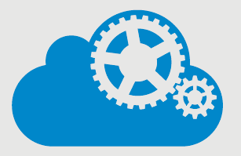
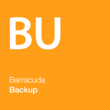
Virtual Appliance
Backup software solution
Scalable for growing environments
Leverage existing underutilized storage and compute infrastructures
1:1 Remote replication included
Barracuda Backup Vx
Hypervisor
Host
Storage
Notes:
And of course we have our virtual appliances – if you’re looking for backup software, or if you have existing underutilized storage and compute infrastructures you would like to leverage.
We’ve purposely priced our solution aggressively against the competition.
Backup Vx starts at just $599/socket, and can protect both physical servers and Virtual machines. And this price includes one-to-one replication to another virtual appliance at no additional cost.
Our integrated cloud replication starts at just $799 per terabyte per year – and that’s after compression and deduplication, so you can see a great value here replicating to the barracuda cloud.

Slide 54
Cloud-to-Cloud Backup
Complete protection for Office 365 – Exchange Online, SharePoint Online and OneDrive for Business
Last line of protection from ransomware
Point-in-time recovery
Notes:
And if you are thinking about or have already migrated to Office 365, with our cloud-to-cloud backup, you can protect exchange online, onedrive for business, and sharepoint online from data loss. This allows you to do point-in-time recovery of your files, folders, and environments without having to rely on microsoft for support – which can take days and sometimes even weeks.

