Slide 1
Black Box
Technology Product Solutions
Michael Falvo
3/14/2016

Slide 2
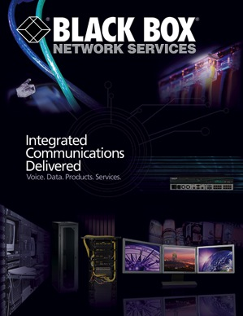
Black Box – Evolution of Technology Solutions
Traditionally known for our
Big Book…
NOW
… a differentiated IT solutions provider
High-Performance Command & Control KVM
Visual Communication

Slide 3
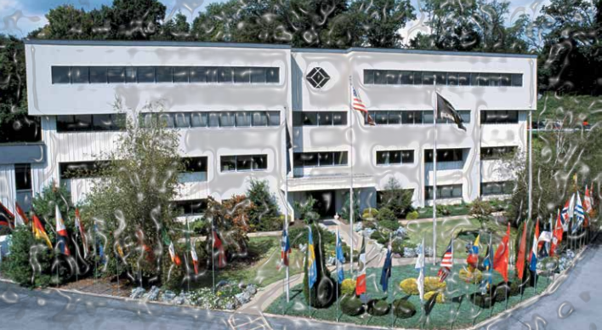
Black Box – Overview
Delivering IT Solutions & Services for 40 years:
Technology Products | Infrastructure | Communication
Global Operations:
Over 175,000 Customers |150 Countries | 4000 Employees
Financial Strength:
$1 Billion in Revenue
NASDAQ: BBOX
Headquartered in Pittsburgh, PA

Slide 4
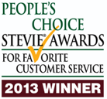
Black Box – Customer Support
U.S. Based Technical Support: 24x7
All Black Box Employees
U.S. Based Multilingual Product Support
Unlimited Pre-Sale & Post-Sale Service

Slide 5
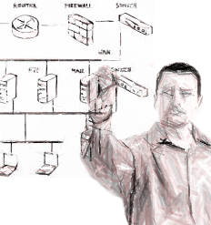
Black Box – Pre-Sale & Post Sale Engineering
Project & Product Integration Consultations
Solution Demonstrations
Solutions Drawlings & Specifications
On-Site Customer Consultations

Slide 6
Black Box – Who Uses Our Solutions?
Fortune 500 – All major U.S. Federal Defense & Civilian Agencies
State & Local Governments – Higher Education & K-12
Commercial
Industrial
Government
Education

Slide 7
Black Box – Mobile Device Charging Carts & Lockers

Slide 8
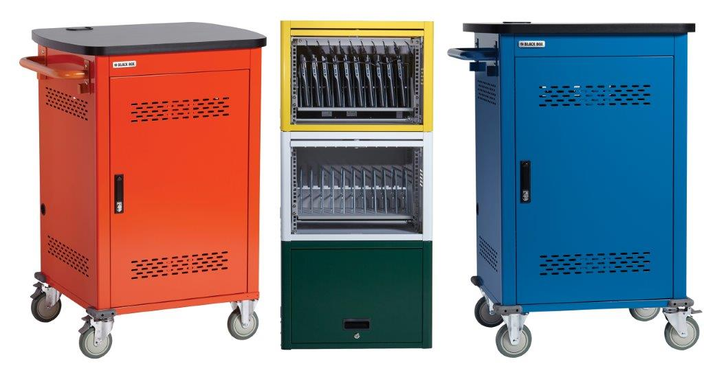
Black Box – Carts & Locker Solution Overview
Standard: LCC Series
Pricing that Matters $
Modular: UD Series
Pay as You Grow $
Deluxe: UCC Series
Flexible | Safe | Easiest to Wire $$$

Slide 9
Markets
Conference & classroom
Visualization & Collaboration

Slide 10
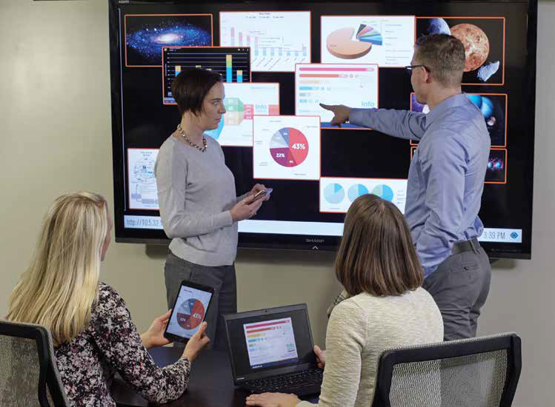
CoalesceTM for Collaboration
Encourage Involvement
Let everyone on your team or in your class share their ideas and information from their own devices
Ensure Dynamic Collaboration
Presenting is no longer one-way. With easy connectivity and sharing, Coalesce enables more time in collaboration
Stay in Control
Allow users to share items freely in open collaboration mode, or approve and reject items in moderated access mode

Slide 11
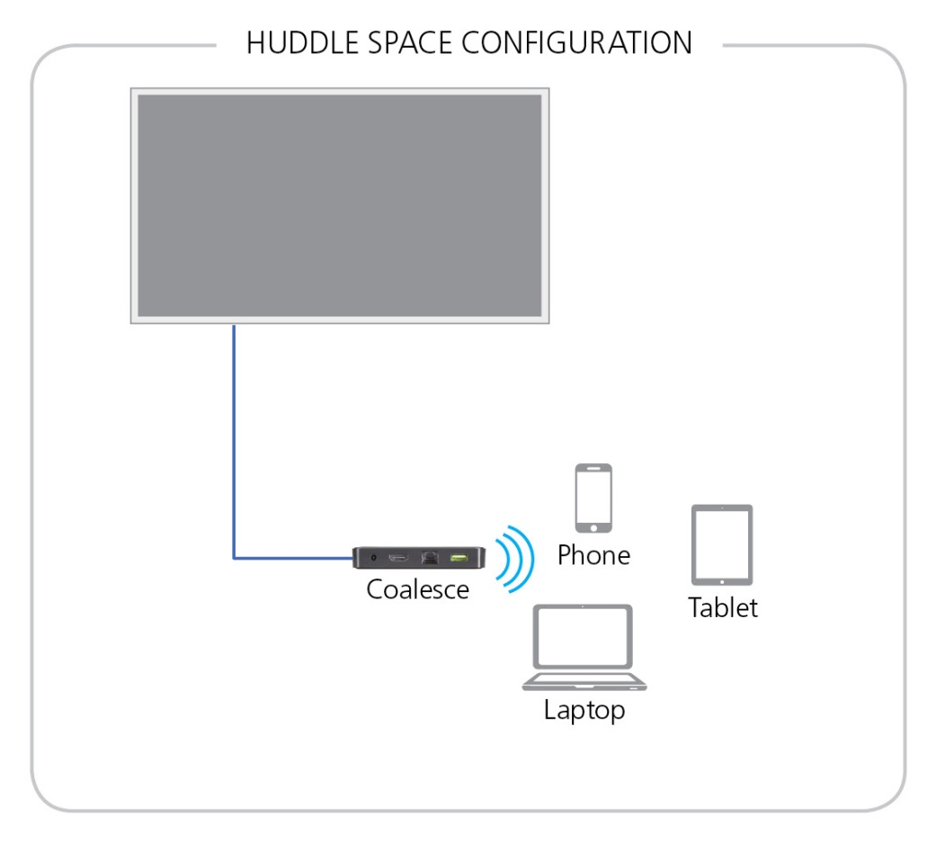
BYOD Solutions
Simple configuration for a small room or any space where people meet to share ideas.
Requires CoalesceTM and a display
Users BYOD
Approx. cost $1200

Slide 12
Thank You
Michael Falvo
Commercial Account Representative
Technology Product Solutions
Black Box Corporation
O | 724.973.6549
C | 412.897.5908
E |Michael.Falvo@BlackBox.com
Michael Falvo
3/14/2016

