Slide 1


ASEAN PPP Summit
The Public-Private Partnership Model and
Its Merits in Attracting Foreign Direct Investment
Luca Bernardinetti, Managing Partner April 4, 2018

Slide 2

ASEAN – PPP Framework
2018 Outlook
Economic Growth
Sound Public Policies
Attractive for FDI
Principles for PPP Framework:
Policy & Organizational Framework
Project selection and implementation
Affordability and Transparency
Transnational Infrastructure Connectivity

Slide 3

Thailand
Policies to attract FDI into the Kingdom:
20-Year National Strategy
Amendment of the Investment Promotion Act 2017
Opportunities:
Infrastructure gap
Increasing number of PPPs
Higher IRR than mature economies

Slide 4

PPP Legal Framework

Slide 5

Public-Private Partnerships

Slide 6
Thai PPP Law
VfM
Evaluation
Introduction of a Value for
Money principle
Evaluation of unsolicited proposals
for “strategic Projects”
Prerequisites
PDF
Clear prerequisites for different
types of PPP arrangements
The creation of a Project
Development Fund (PDF)
PPP Unit
Transparency
The establishment of a central
PPP unit
Transparent procedures to streamline
the PPP bidding process
Strategic Projects
The creation of a master plan
of “Strategic Projects”

Slide 7
PPP Models
Privatisation
Concession
DBFM-Operate
PPP Models
Design Build Finance Maintain
Degree of Private Sector Risk
Build and Finance
Operate and Maintain
Design and Build
Degree of Private Sector Involvement

Slide 8
Types of PPPs
Types of PPPs
Types of PPPs
Railways
Airports
Transportation
Energy
Hospitals
ICT
Roads & Bridges
Ports & Maritime

Slide 9
Types of PPPs
Types of PPPs
Principles of PPPs
Output-Based Specifications
  Contracting Authority defines the service required
  Design of the works to deliver that service lies with the private sector
Long-term contractual arrangements
  Typically between 15 and 30 years and over
  Credit enhancement often sought for long-term PPPs
Value for Money
Cost measured against conventional procurement.
Whole life costs and quality are combined to gauge VFM
Transfer of Risk
Transfer of design and construction risk
Risk of ownership transferred to the private sector
Market Competition
  Competition will drive best value
  Gives public sector access to innovation
Whole-Life Costing
Long term responsibility for building operation and maintenance
Focus on reducing cost

Slide 10

Finance Structures

Slide 11
Types of PPPs
Types of PPPs
Common SPV Structure
Public Partner
PPP Contract
Commercial Banks
Bond Investors
Other Finance Providers
Equity Investment
Subordinated Loans
Loan Agreement
Shareholders
Private Partner
SPV (Special Purpose Vehicle)
Lenders
Equity
Debt
Construction Agreement
EPCM Contractor
O&M Agreement
Construction Contractor
Operating and Maintenance Contractor

Slide 12
Types of PPPs
Types of PPPs
Project Due Diligence
Creditworthiness Analysis
Project Owner’ Credit Rating (4 C’s of Credit)
Business Plan and Implementation
Financial Condition and Solvency
Legal Structure of the PPP
Legal and Organizational Scheme of the Project
Contracts, Arbitration and Enforceability
Ownership Structure of the Project
Credit Enhancement
Performance Guarantees: SBLC, Demand Guarantees, Surety Bonds, Performance / Advance Payment Bonds
Insurances: PRI, ECG, Construction Risk Insurance, AADI
Feasibility study
Technical solutions and equipment under the Project
FX Risk Analysis and hedging
Reports of financial / technical advisors

Slide 13
Types of PPPs
Types of PPPs
Credit Enhancement
Credit Enhancement mitigates political, technological or development risks and it can be pivotal in obtaining the Credit Rating sought by Investors. It aims to achieve the two-fold goal: (1) viability of the project and (2) lowering the cost of financing and resulting in a more competitive price and better value for money.
Sponsor
Bank
Multilateral
Guarantee
Credit Wrap
Sovereign Guarantee
Multilateral Product

Slide 14
Types of PPPs
Types of PPPs
Non-Recourse Finance
Industrial
Renewable Energies

Slide 15
Types of PPPs
Types of PPPs
Transaction Advisory Services
Due Diligence
KYC, AML, FCC checks, Feasibility Study, Central Credit Registers, etc.
Credit Report
Creditworthiness Report and fact-checking for lenders and underwriters
Credit Enhancement
Advisory and Structuring of Guarantees underpinning the Credit Facility
Financial Structure
Advisory and Structuring of Debt/Equity Model, Trade Finance Advisory
Legal & Contracts
Legal & Contractual Structuring, Arbitration & Enforceability, Ring-fencing
Tax Advisory
Tax Structuring, Transfer Pricing, Tax Planning, Auditing, Tax Compliance
Closing Assistance
Closing and Post-Closing Assistance, Credit Restructuring.

Slide 16

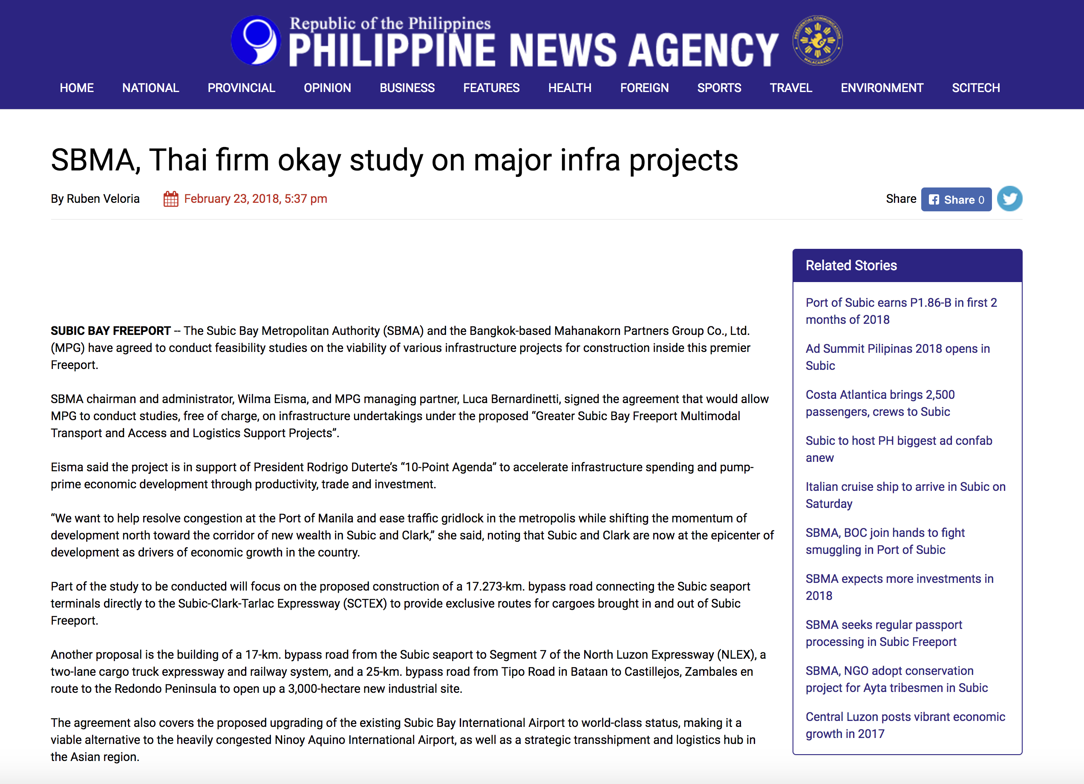

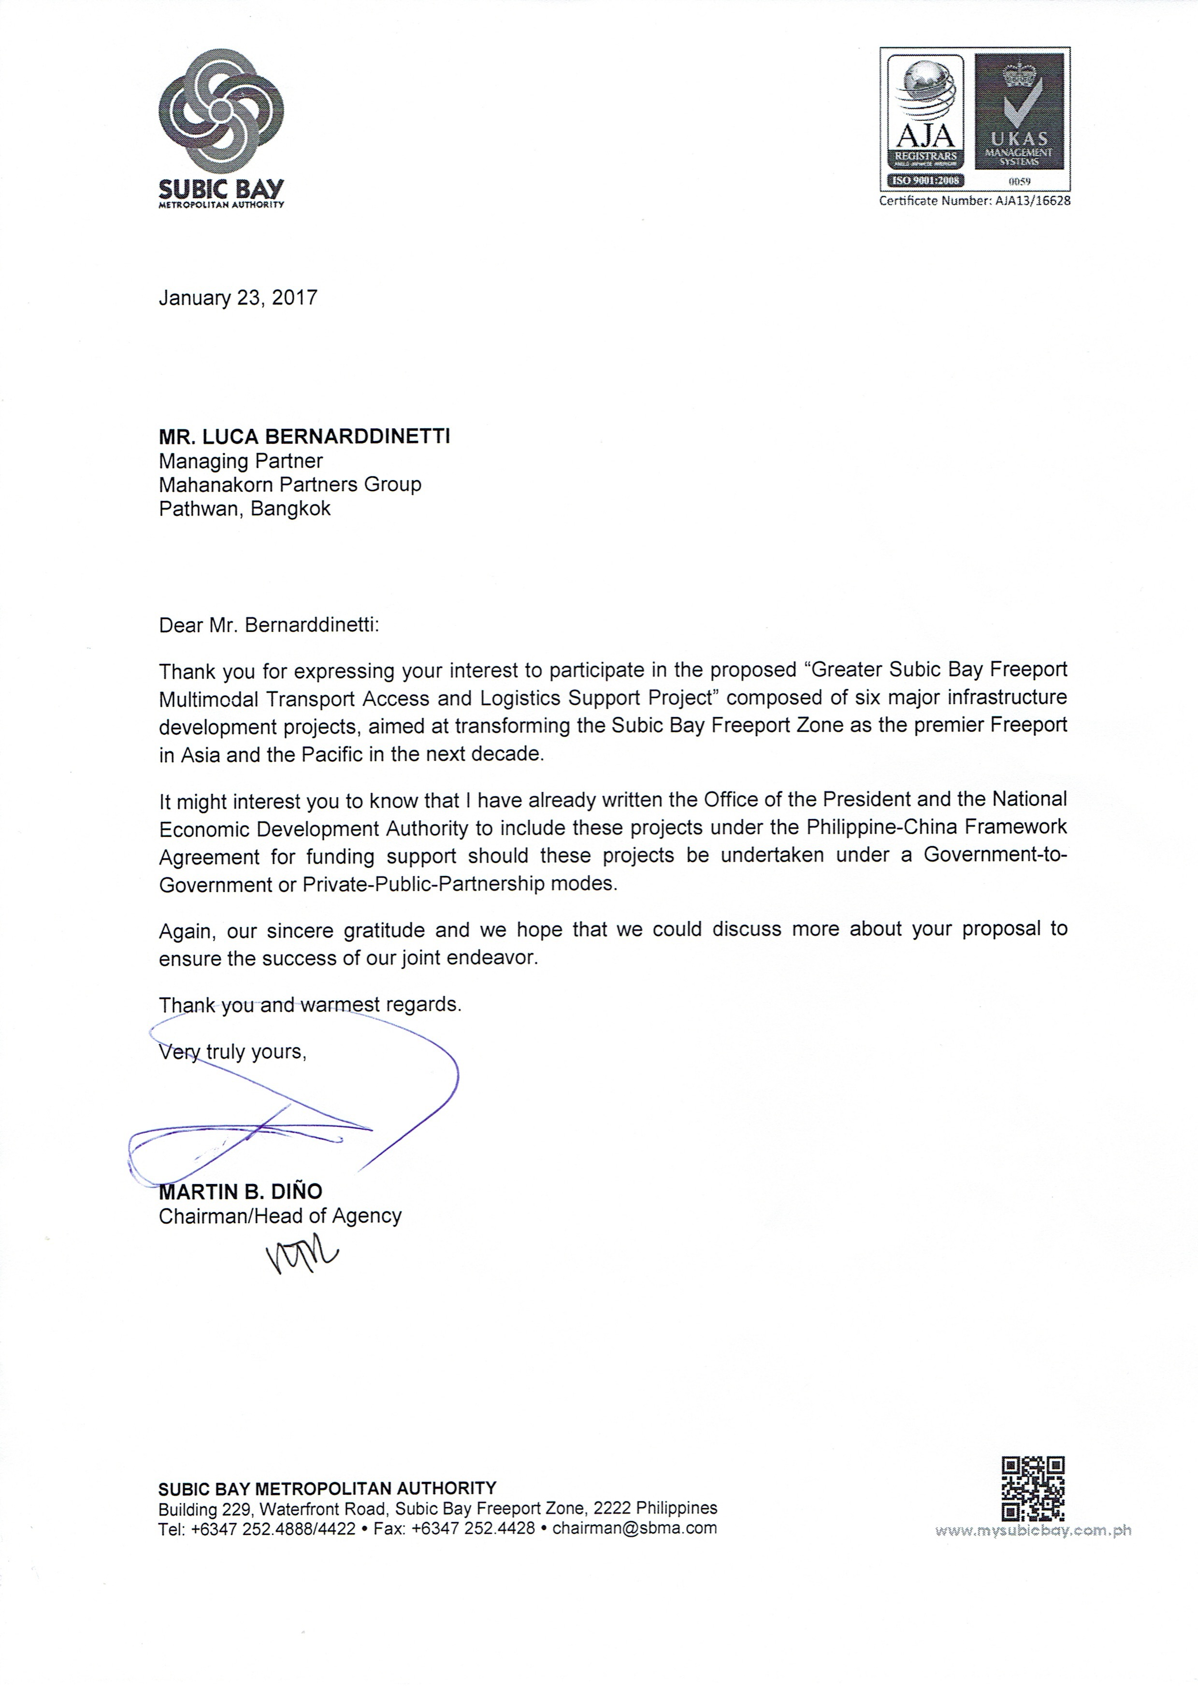
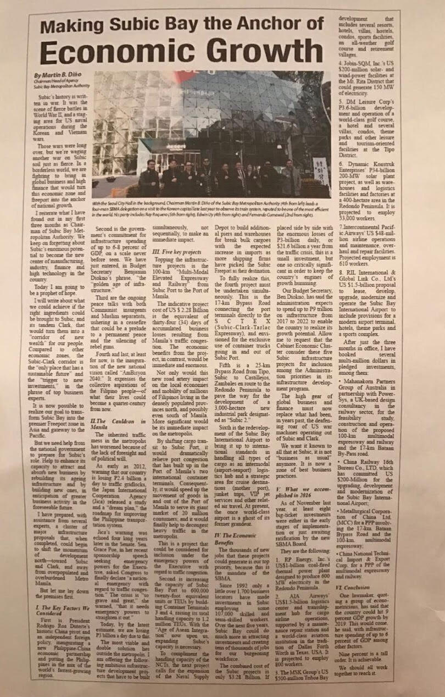
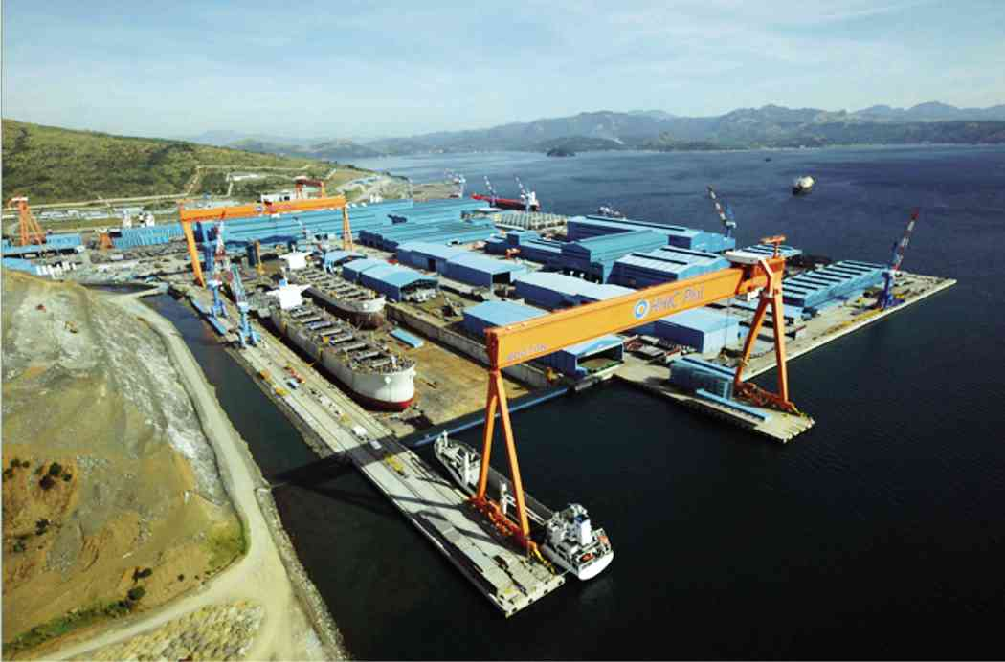
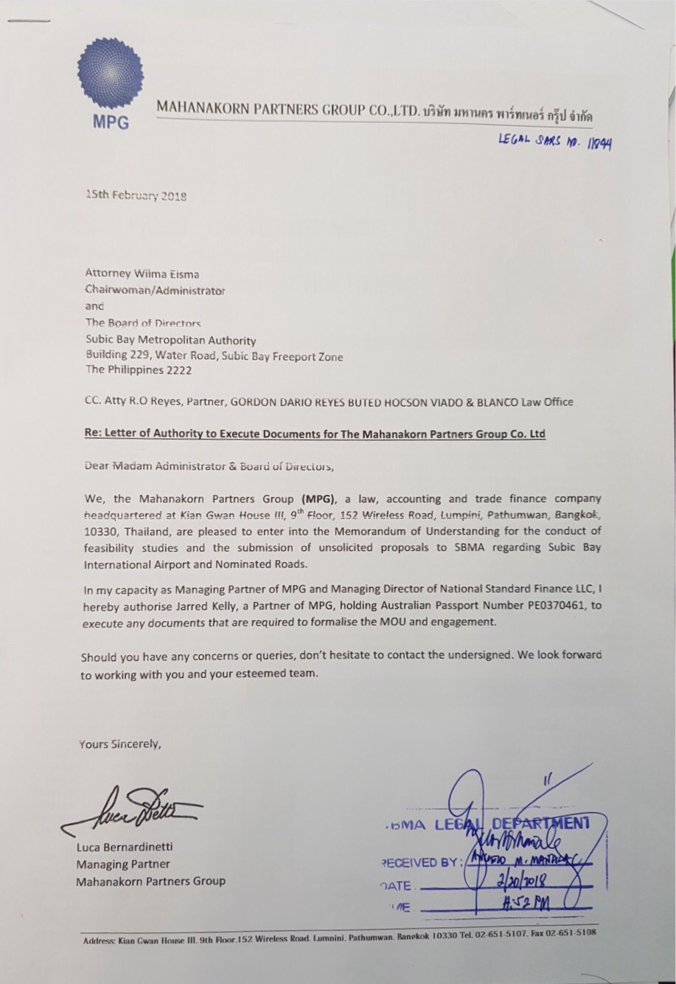


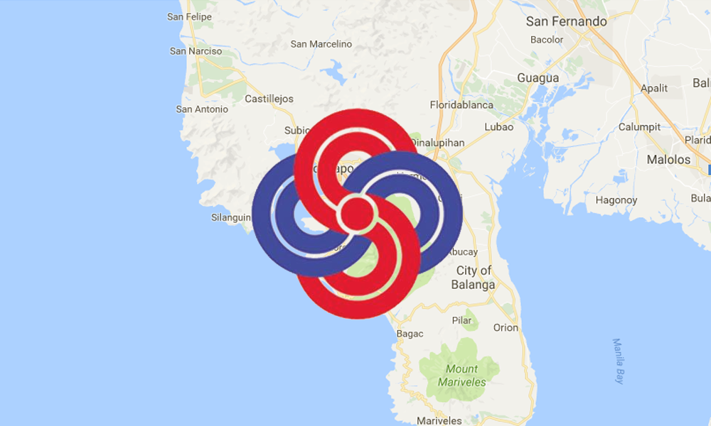



Types of PPPs
Types of PPPs
Our Work in Images

Slide 17
ASEAN PPP Summit
The Public-Private Partnership Model and
Its Merits in Attracting Foreign Direct Investment
Luca Bernardinetti, Managing Partner April 4, 2018

Slide 18
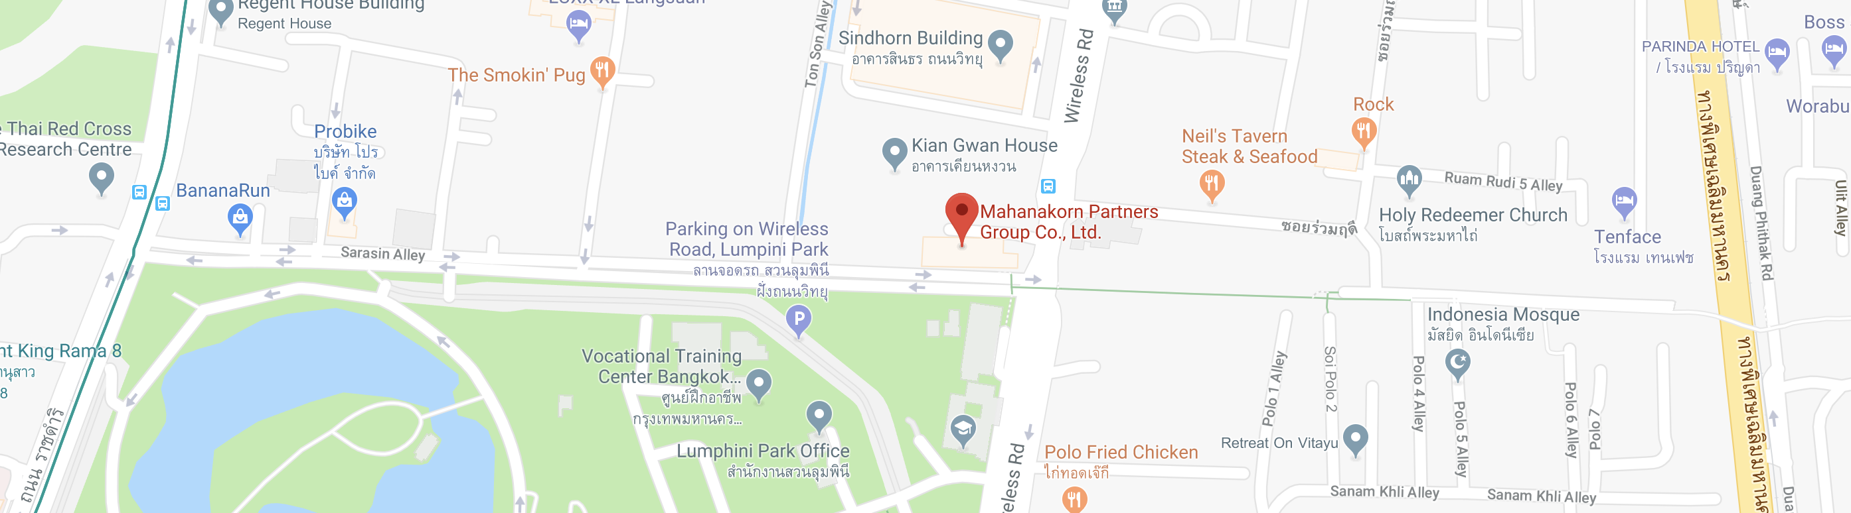
Types of PPPs
Types of PPPs
THANK YOU!
Mahanakorn Partners Group
Kian Gwan House III, 9th Floor, 152 Wireless Road
Lumpini, Pathumwan, Bangkok, 10330, Thailand
Tel: +66 (0) 2651 5107
Fax: +66 (0) 2651 5108
info@mahanakornpartners.com
www.mahanakornpartners.com

