Slide 1
#1 Online Beer & Liquor Store in Thailand
Jerome Le Louer
Founder & CEO

Slide 2
1. Bio: 10 years experience as a CFO in South East Asia, based in Bangkok

Slide 3
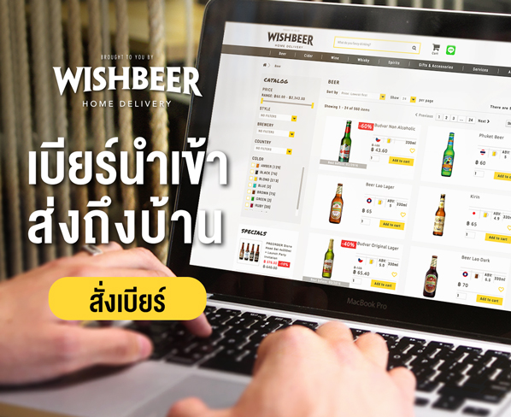
2. Launched Wishbeer in 2013, an e-commerce store focusing on Imported Beers

Slide 4
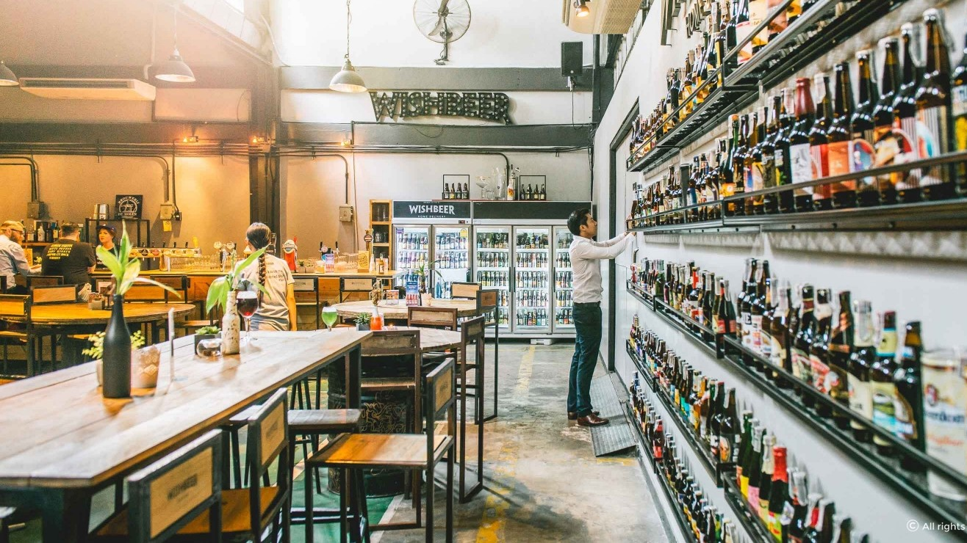
3. In 2015, we started one of the largest Beer Bar & Bottle Shop

Slide 5
THANK YOU! Let’s discuss this further over a beer…
Jerome Le Louer
CEO / Founder
jerome@wishbeer.com
+66-83-817-7402

